Slide 1
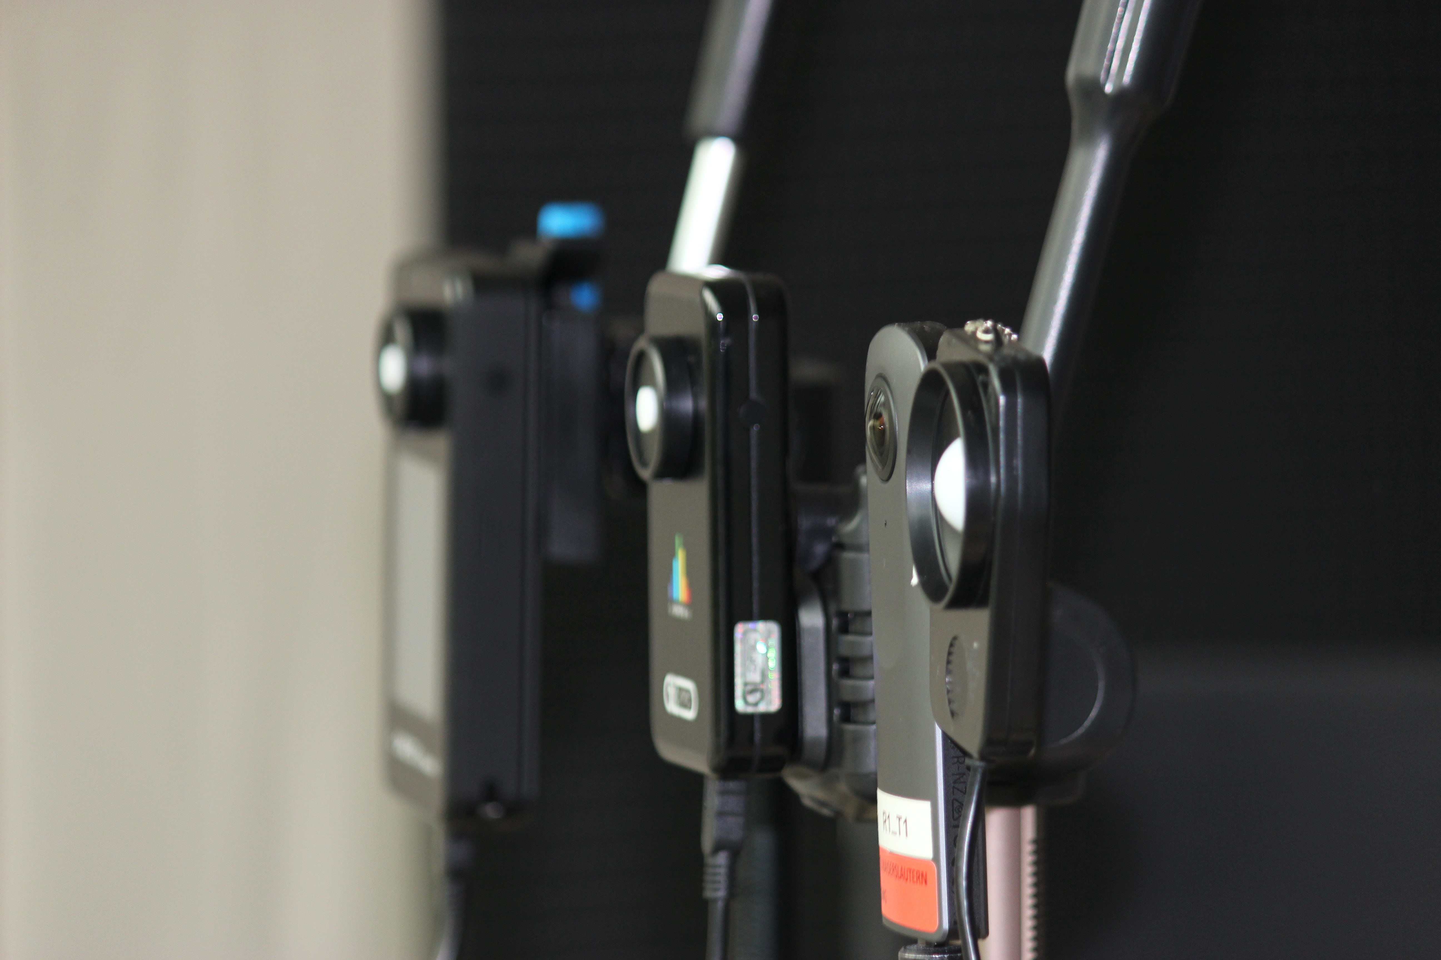
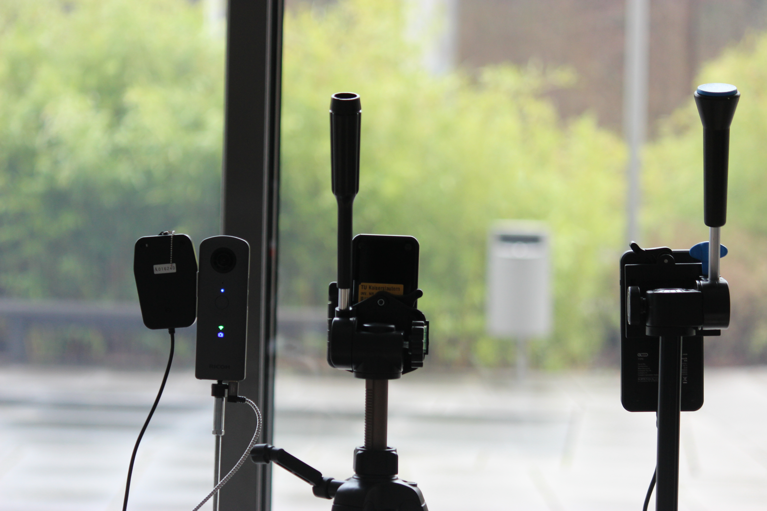

Slide 2
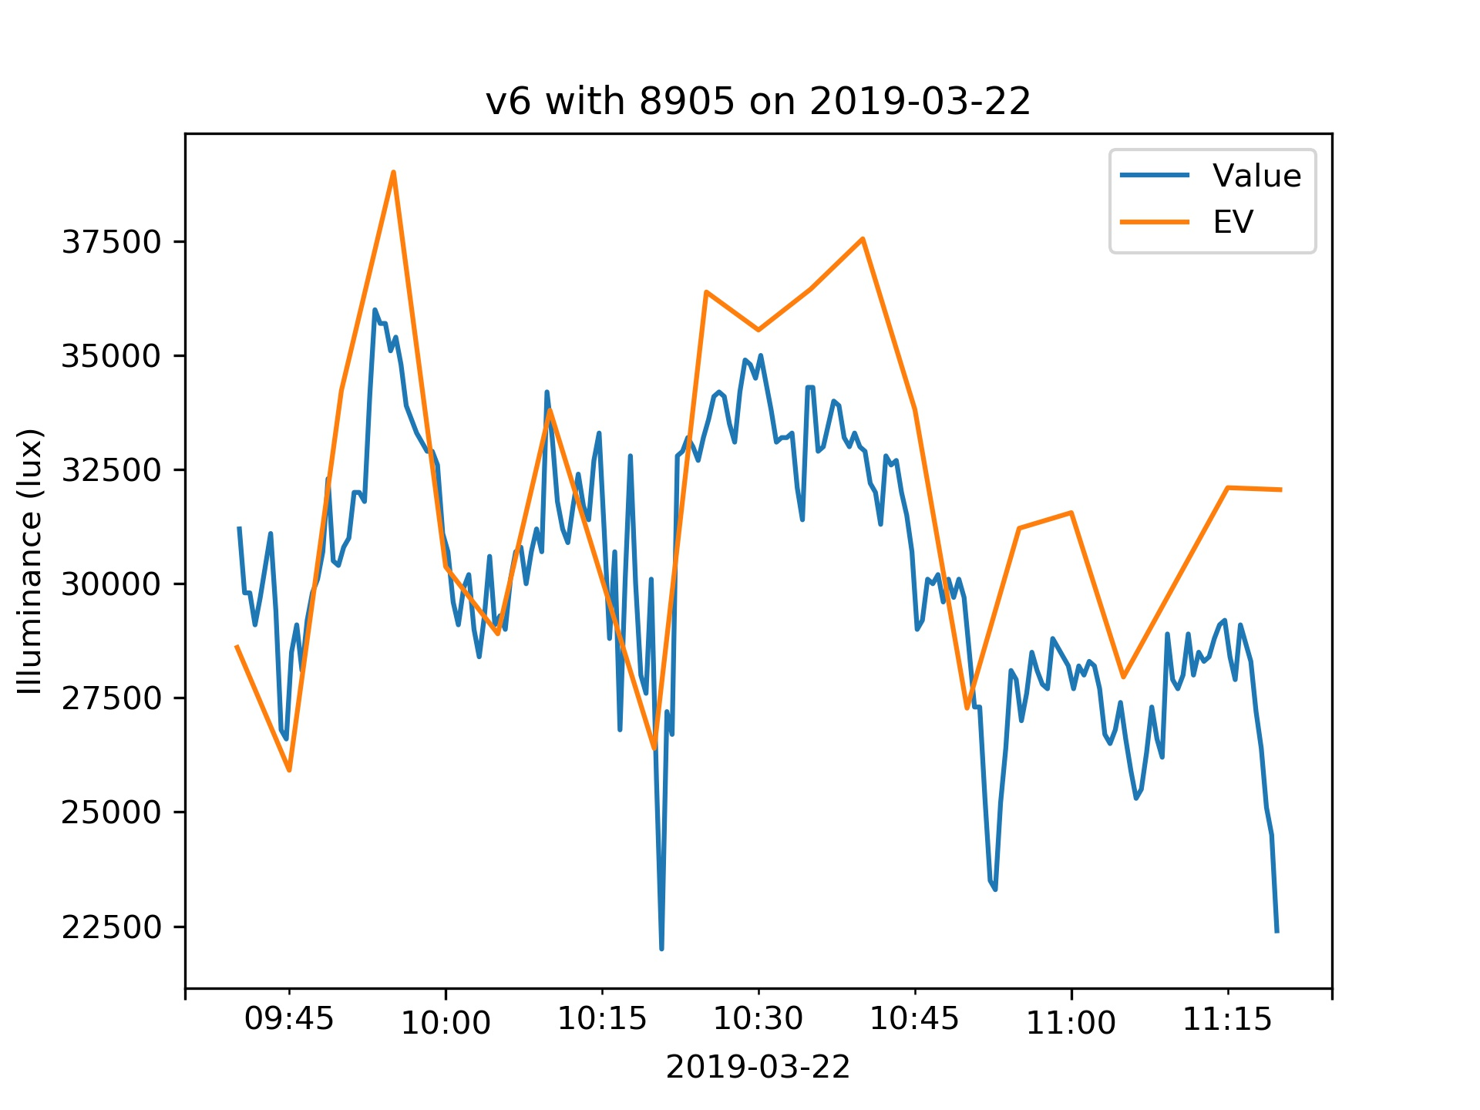
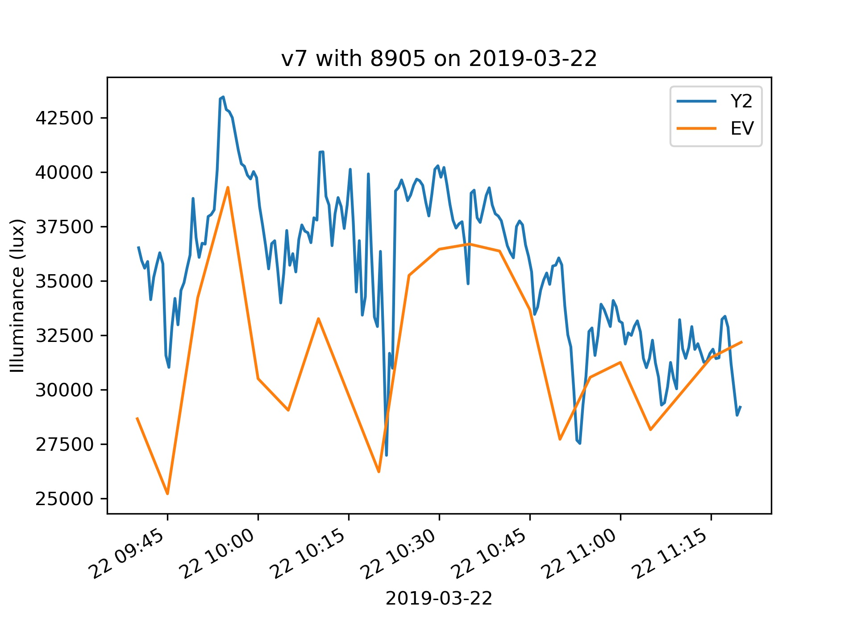
v6 - Illuminance sensor v7- Spectrometer

Slide 3
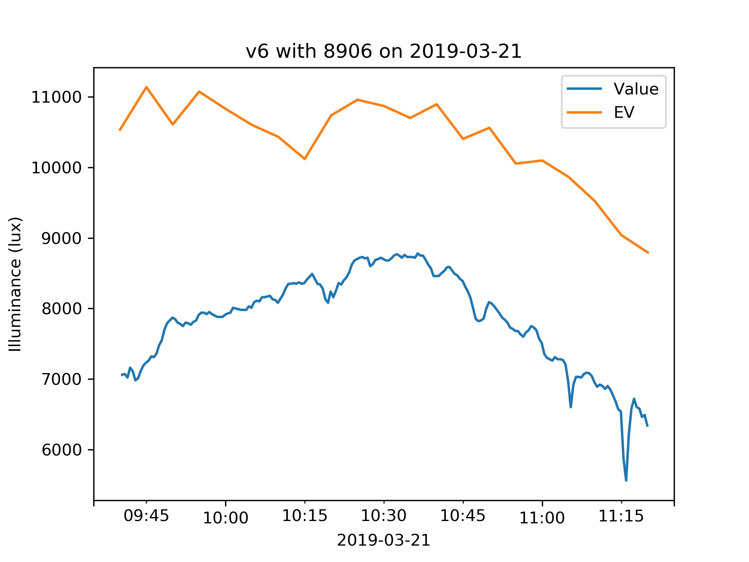
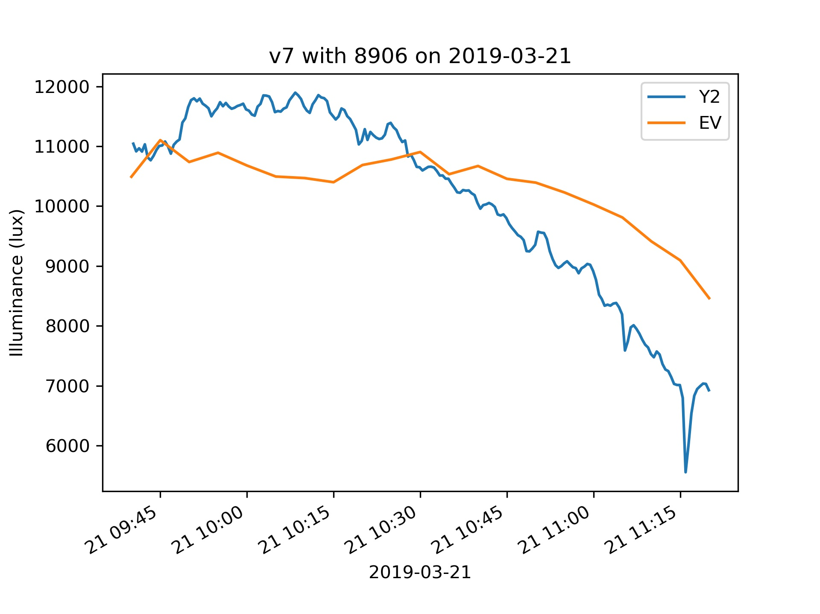
v6 - Illuminance sensor v7- Spectrometer

Slide 4
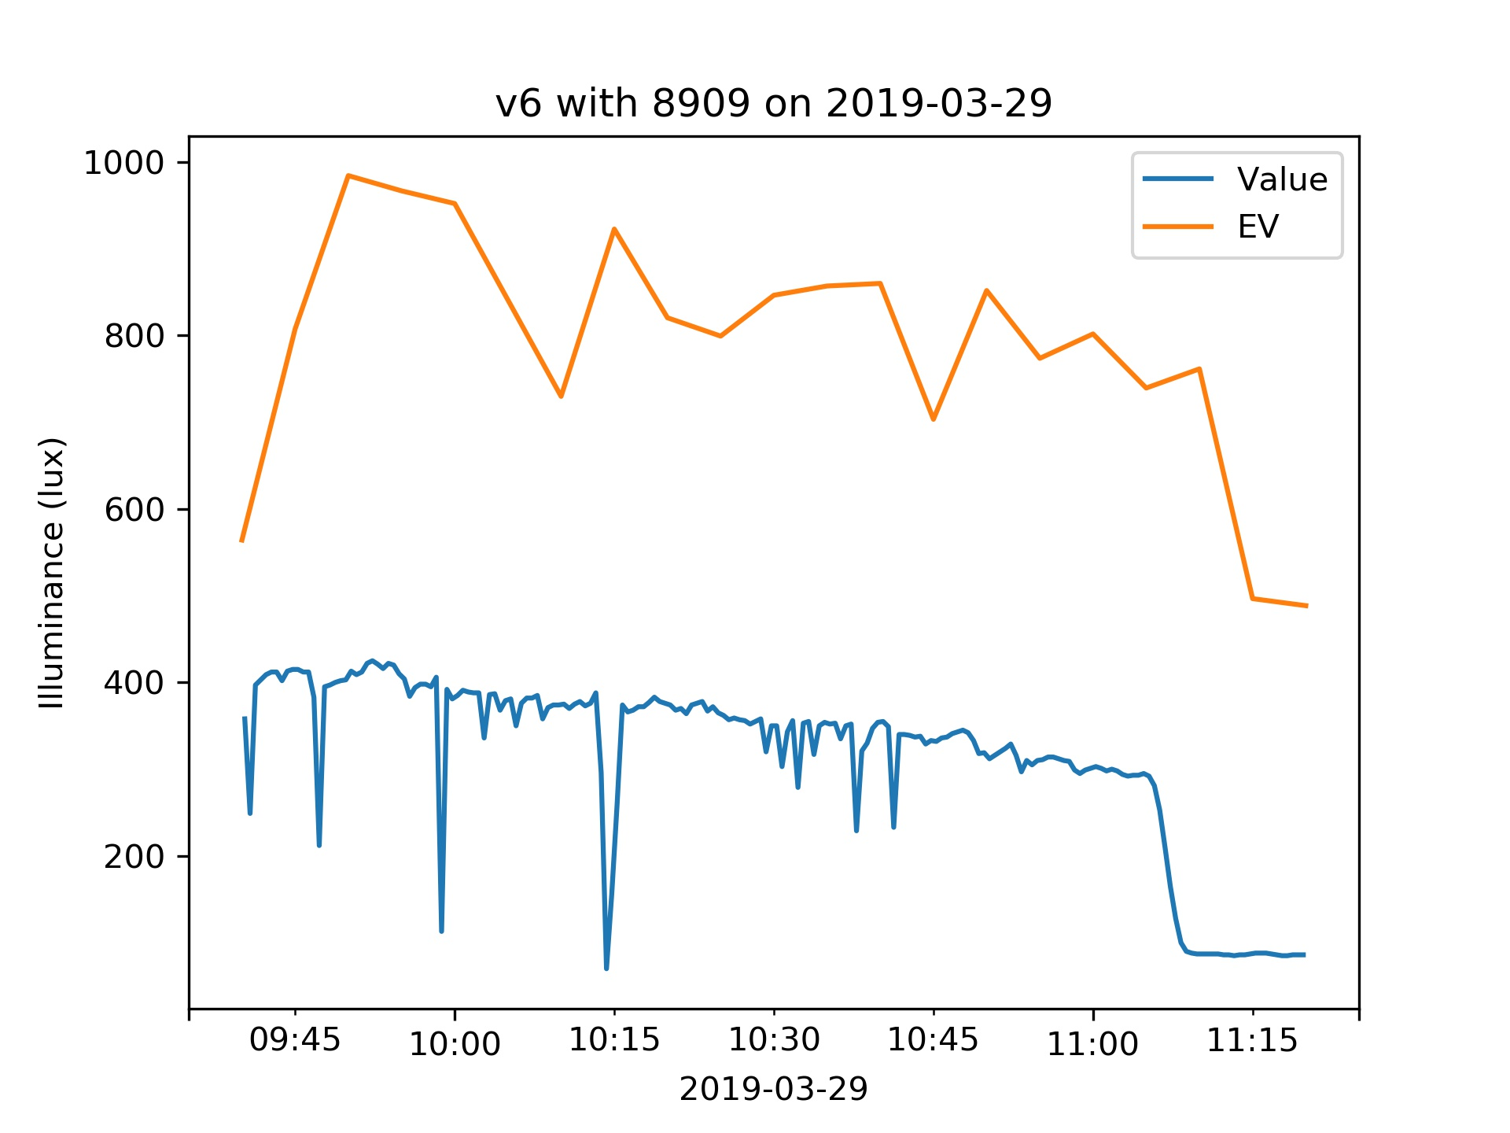
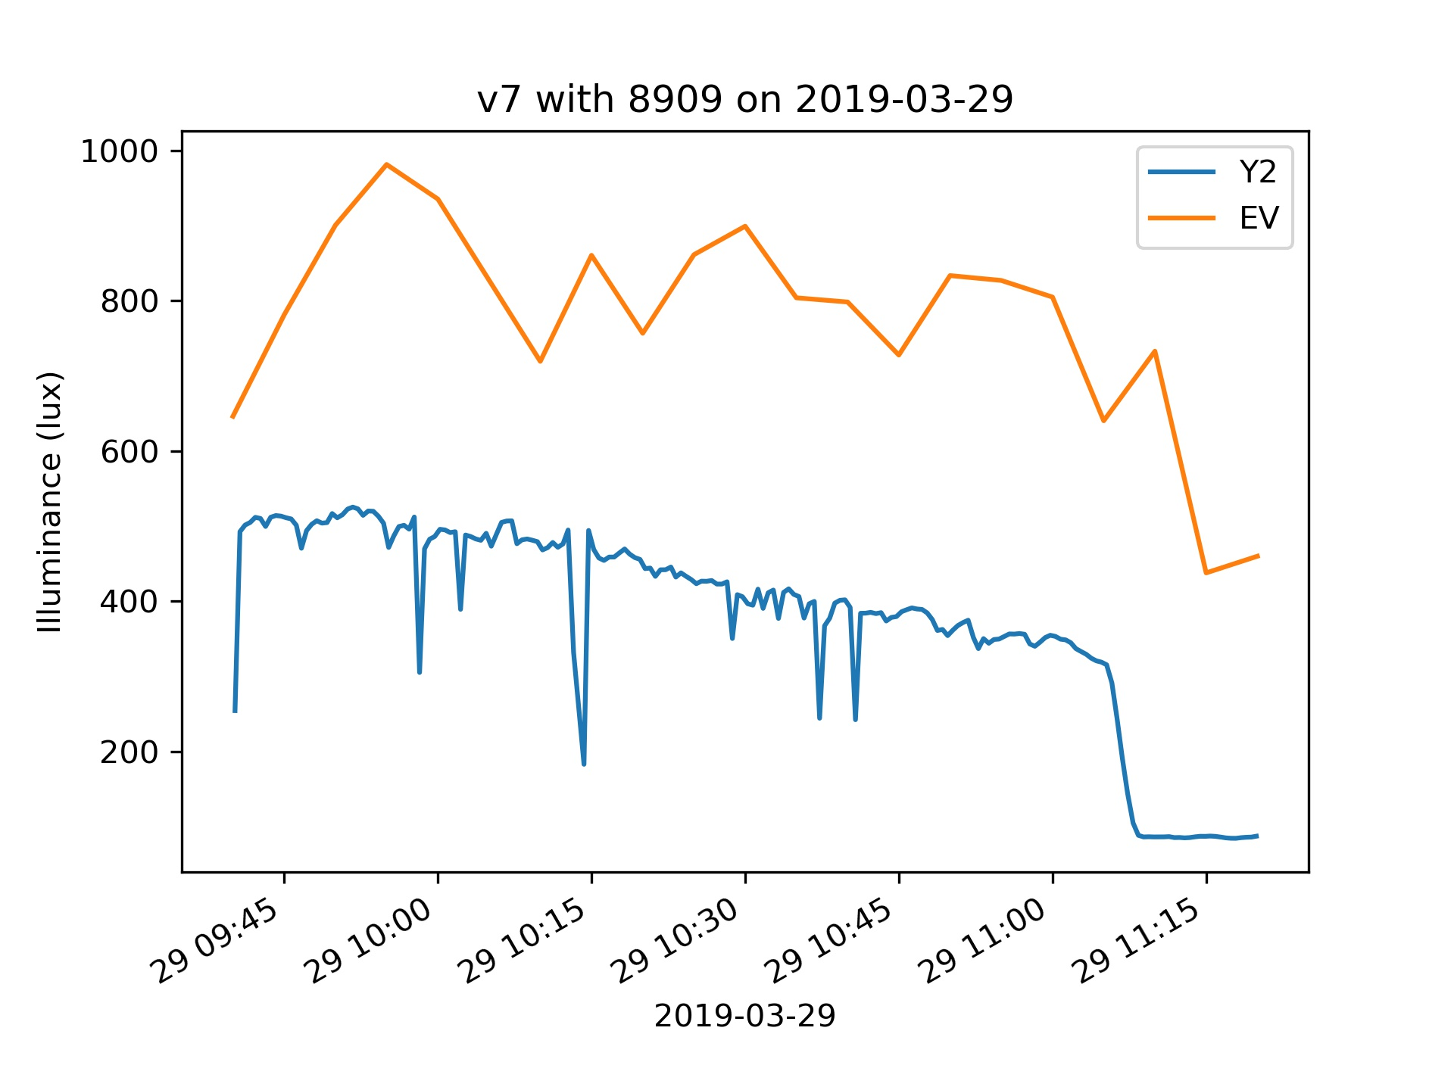
v6 - Illuminance sensor v7- Spectrometer

Slide 5
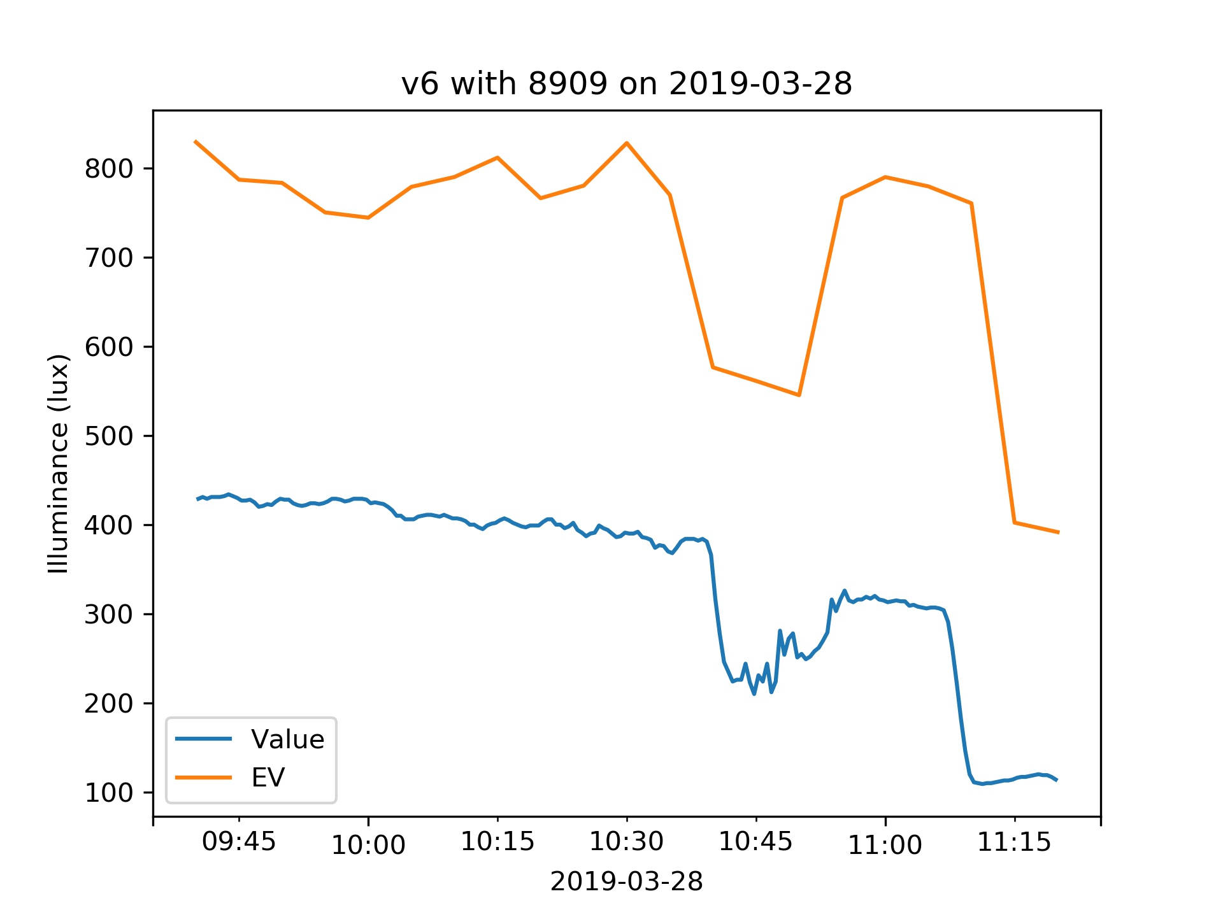
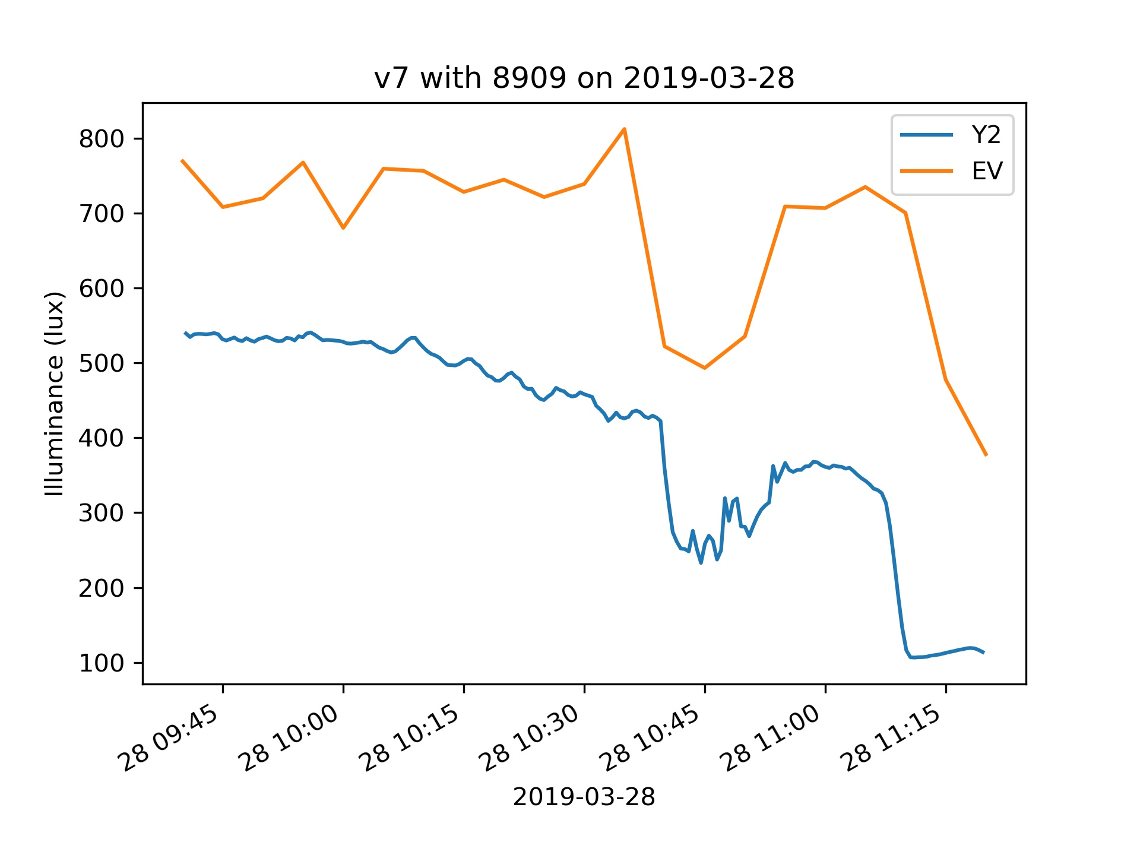
v6 - Illuminance sensor v7- Spectrometer

Slide 6
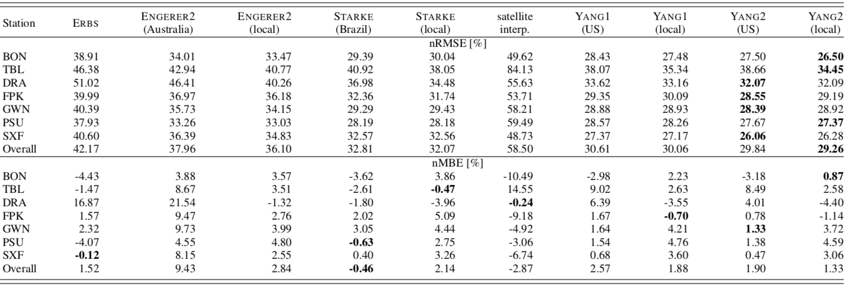
Station | NN
BON | 20.52
DRA | 23.92
PSU | 18.78
BON | 0.26
DRA | -0.01
PSU | -0.01

